Slide 1

DIVIDE AND CONQUER
- Namrata Prasad
- 181210032
- CSE 2nd Year

Slide 2
Description
Divide and Conquer is an algorithm design paradigm based on multi-branched recursion. A divide-and-conquer algorithm works by recursively breaking down a problem into two or more sub-problems of the same or related type, until these become simple enough to be solved directly. The solutions to the sub-problems are then combined to give a solution to the original problem.
Some common applications:
Binary Search
Merge Sort
Quick Sort
Closest Pair of Points
Strassen's Multiplication (algorithm to multiply 2 matrices)

Slide 3
Divide And Conquer algorithm :
The algorithm is divided into three parts:
Divide: Dividing the problem into some sub problem.
Conquer: Solve sub problem by calling recursively until sub problem solved.
Combine: Combine solved sub problems to get the final solution.
DAC(a, i, j)
{
if(small(a, i, j))
return(Solution(a, i, j))
else
m = divide(a, i, j)
b = DAC(a, i, mid)
c = DAC(a, mid+1, j)
d = combine(b, c)
return(d)
}

Slide 4
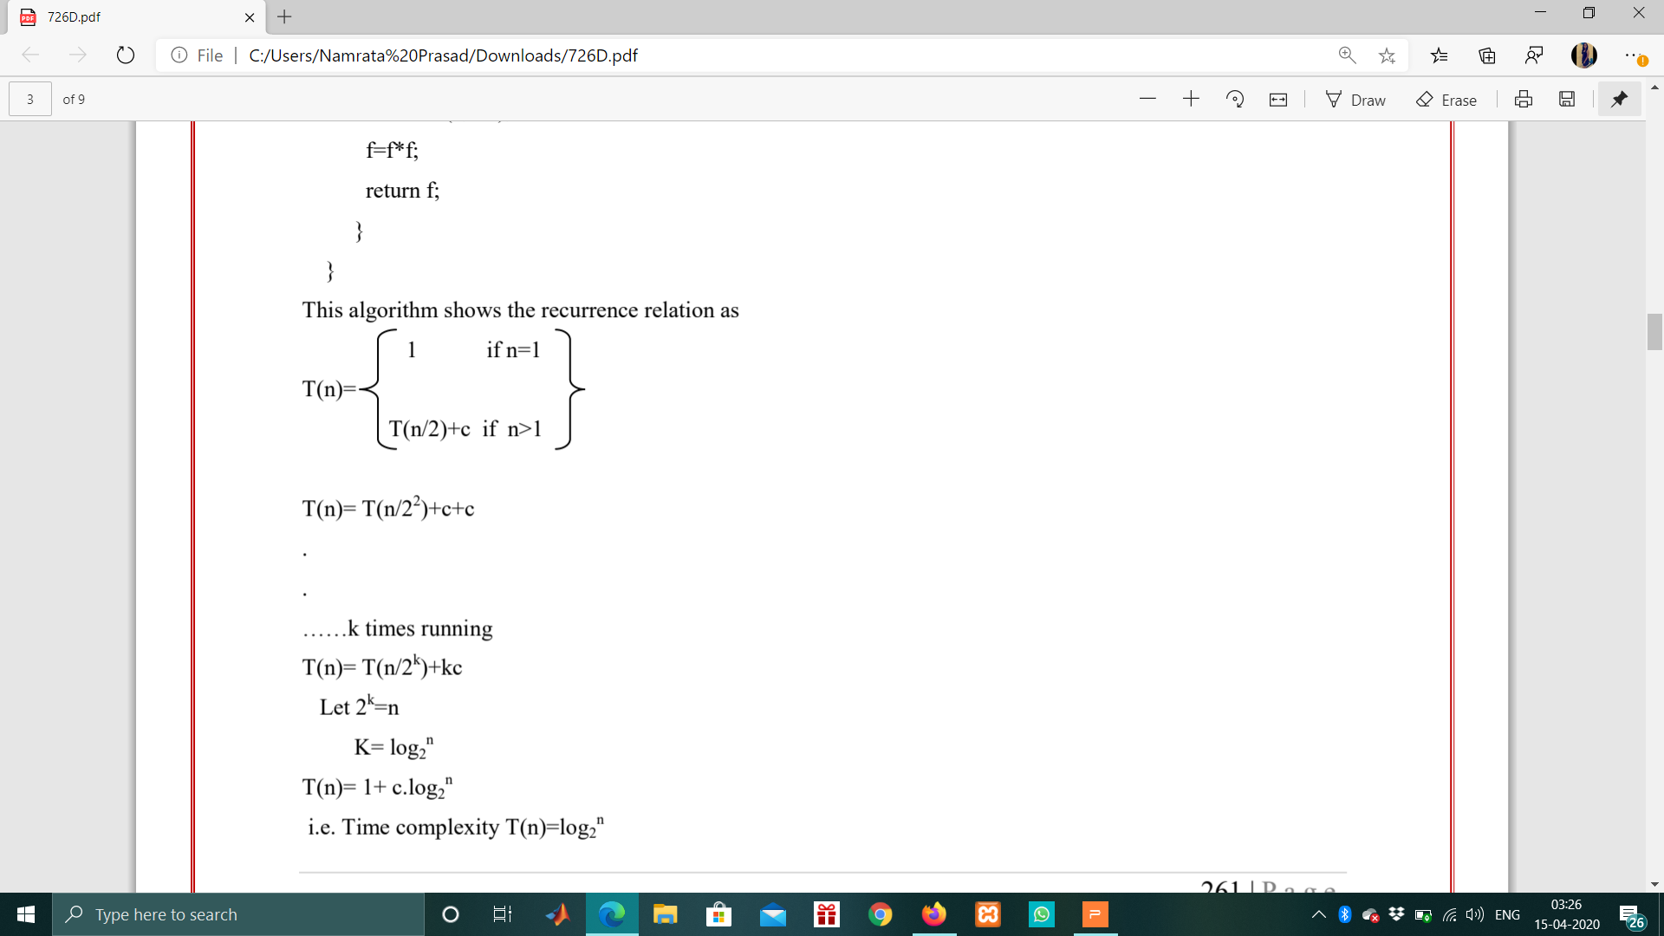
Time Complexity for DAC algorithm :
T(n)= T(n/2²)+c+c
.
.
……running k times
T(n)= T(n/2^{k})+kc
Let 2^{k}=n
k= log₂n
T(n)= 1+ c.log₂n
Therefore, time complexity T(n)=log₂n

Slide 5
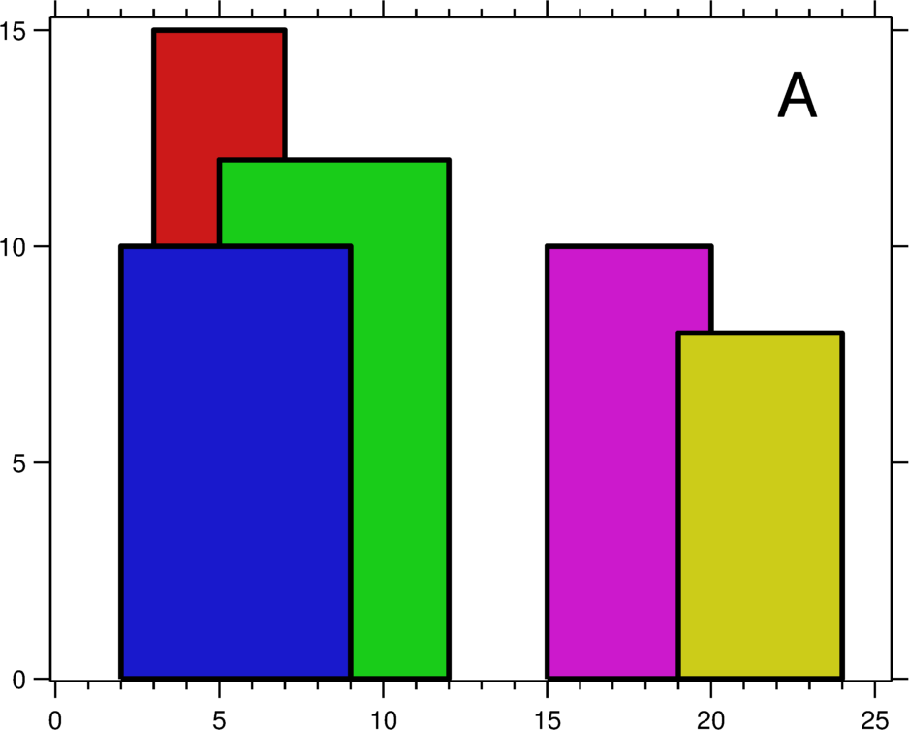
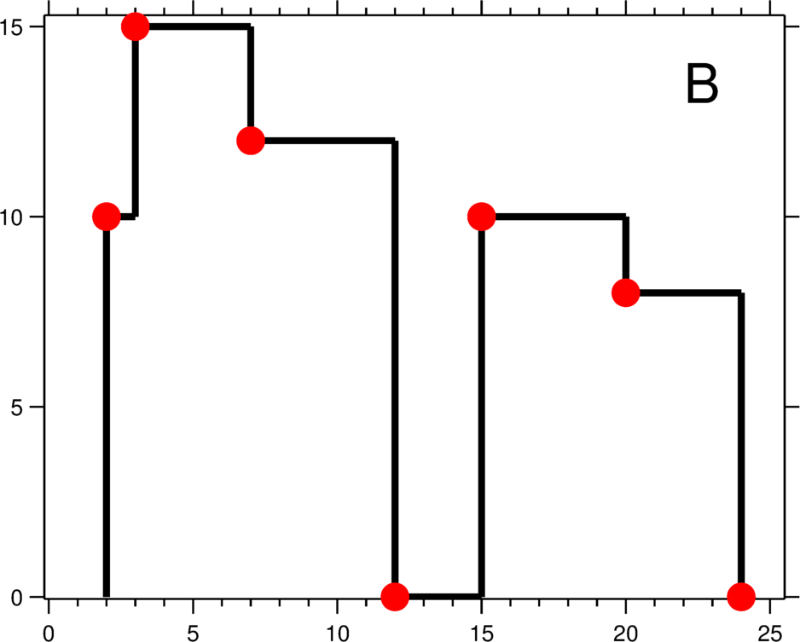
Problem Statement
The Skyline Problem
A city's skyline is the outer contour of the silhouette formed by all the buildings in that city when viewed from a distance.
Given n rectangular buildings in a 2-dimensional city, computes the skyline of these buildings, eliminating hidden lines. The main task is to view buildings from a side and remove all sections that are not visible.
The geometric information of each building is represented by a triplet of integers [L_{i}, H_{i}, R_{i}], where L_{i} and R_{i} are the x coordinates of the left and right edge of the ith building, respectively, and H_{i} is its height. It is guaranteed that 0 ≤ L_{i}, R_{i} ≤ INT_MAX, 0 < H_{i} ≤ INT_MAX, and R_{i} - L_{i} > 0.
The output is a list of "key points" (red dots in Figure B) in the format of [ [x1,y1], [x2, y2], [x3, y3], ... ] that uniquely defines a skyline.
A skyline is a collection of rectangular strips. A rectangular strip is represented as a pair (left, ht) where left is x coordinate of left side of strip and ht is height of strip.

Slide 6
ALGORITHM
The idea is similar to merge sort
Find the skyline of all the buildings and store it in an array/vector of pairs.
If end> start
1. Find the middle point to divide the array into two halves:
middle mid = (start+end)/2
2. Call findskyline function for first half:
Call findskyline(start, mid)
3. Call findskyline function for second half:
Call findskyline(mid+1, end)
4. Merge the two skylines solved in step 2 and 3:
Call mergeskyline(start, mid, end)

Slide 7
Algorithm to Merge two Skylines
STEPS:
Start from first strips of two skylines.
Compare x coordinates. Pick the strip with smaller x coordinate and add it to result.
The height of added strip is considered as maximum of current heights from skyline1 and skyline2.
Remove all redundant strips(No more than 1 strip should be present with one height)
Implemention:
Skyline1 = {(1, 11),(16, 0)}
Skyline2 = {(14, 3),(19, 0)}
Result = {}
h1 = 0, h2 = 0

Slide 8
Implementation
STEP1: Compare (1, 11) and (14, 3).
Since first strip has smaller left x, add it to result and increment index for Skyline1.
h1 = 11, h2=0, New Height = max(11, 0)
Result = {(1, 11)}
STEP2: Compare (16, 0) and (14, 3).
Since second strip has smaller left x, add it to result and increment index for Skyline2.
h1 = 11, h2=3, New Height = max(11,3)
Result = {(1,11),(14, 11)}
STEP3: Compare (16, 0) and (19, 0).
Since first strip has smaller left x, add it to result and increment index for Skyline1.
h1 = 0, h2=3, New Height = max(0,3)
Result = {(1,11),(14, 11),(16,3)}
STEP4: Now since only one stip in left(in skyline2), we add it to the result.
Result = {(1,11),(14, 11),(16,3),(19,0)}
STEP5: Remove redundant strips
Result = {(1,11),(16,3),(19,0)}

Slide 9
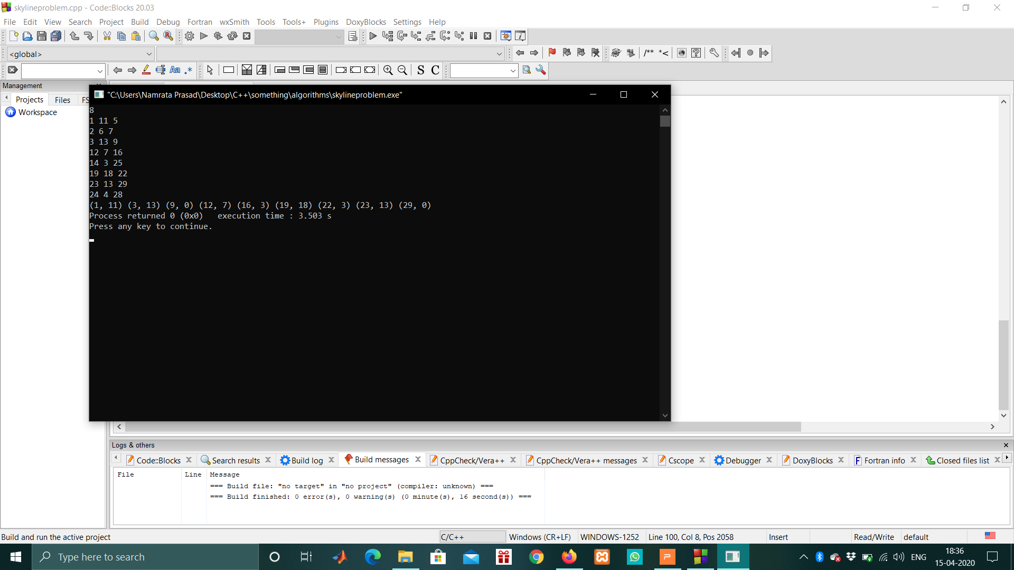
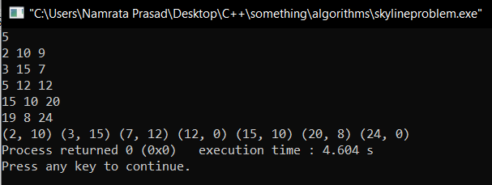
OUTPUT
INPUT FORMAT:
The first line of input has an integer N denoting the number of buildings.
The next N lines containes 3 integers- Li Hi Ri
OUTPUT 1:
OUTPUT 2:

